Slide 1


Discuss:
Are you in favor of legalizing the sale of kidneys? Why or why not?
Do you support the move to distribute organs in the United States based on “ benefit” rather than simply who’s been on the waiting list longest? Why or why not?
…at how the market (legal AND illegal) for kidneys works by clicking here or on the picture below. (Law and Order SVU) (6:18 minutes)
Notes:
http://criticalcommons.org/Members/gdmateer/clips/the_office_moroccan_christmas_final2.m4v/view?searchterm=the%20office

Slide 2
What is a demand curve? What is a supply curve?
What’s the difference between “movements” along a curve and “shifts” of a curve?
How do supply and demand curves determine a market’s equilibrium price and equilibrium quantity?
If there’s a shortage or surplus, how does price moves the market back to equilibrium?
To First
Active Learning
To Video

Slide 3
Finding the Equilibrium Price and Quantity
Price of cotton (per pound)
Market equilibrium occurs at point E, where the supply curve and the demand curve intersect.
Supply
$2.00
1.75
1.50
1.25
Equilibrium price
E
Equilibrium
1.00
0.75
0.50
Demand
0
7
10
13
15
17
Equilibrium quantity
Quantity of cotton (billions of pounds)

Slide 4
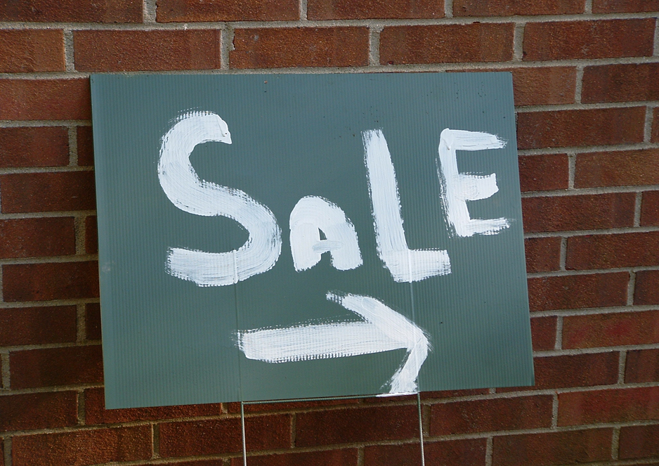
The Demand Schedule and the Demand Curve
The Law of demand: a higher price for a good or service leads people to demand a smaller quantity.

Slide 5
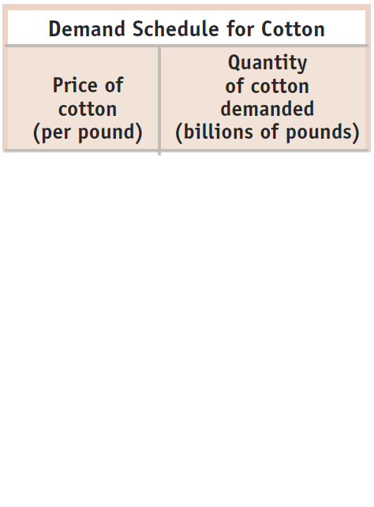
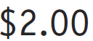
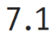
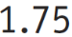
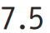
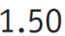
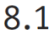
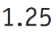
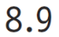
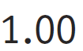
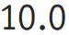
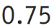
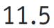
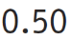
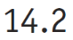
The Demand Schedule and the Demand Curve
Price of cotton
(per pound)
$2.00
1.75
1.50
1.25
1.00
0.75
As price falls, the quantity demanded rises
Demand curve, D
0.50
0
7
9
11
13
15
17
Quantity of cotton
(per pound)

Slide 6

Don’t be sloppy in terminology:
a “change in demand”
a “change in quantity demanded”
Back to Table of contents

Slide 7
Changes in Demand vs. Changes in Quantity Demanded
Change in demand
Change in quantity demanded
Price
Price
$1.00
$1.00
D₂
.50
D₁
D₁
10
15
10
14.2
Quantity
Quantity
Back to Table of contents

Slide 8
Three ways to show Demand
DEMAND SCHEDULE
Price (pepsi) Qty demanded (bottle of pepsi)
0.25 ?
0.50 4
0.75 3
1.00 2
1.25 1
1.50 ?
2) DEMAND EQUATION
Equation to represent the Demand for Pepsi can be either:
P = 1.50 - 0.25 Q
or
Q = 6 - 4 P
3) DEMAND CURVE
Try to graph this demand curve on your own:
*) 1.50 is the y-intercept
* ) 6 is the x-intercept
Notes:
A demand curve can be represented three ways: (1) graph; (2) price and quantity demanded schedules; and (3) in equation.
From the above “demand schedule”, we could see that every time price rises by 0.25, the quantity demanded falls by 1 unit; so the slope is 0.25; and in the context of Math form: y = a + b.x ; with b as the slope, and a as the constant; or P = a – b.Qd; or P = a – 0.25 Qd. To find the constant a, take one pair of points, let’s say at price $0.50, quantity demanded is 4, so plug this back to P = a -0.25. Qd; so 0.50 = a – 0.25 (4); you get 0.50 = a – 1.00; so a must be 1.50.
Sometimes, economists like to use the alternative equation in the form of Q = a – b.P; to convert from the first equation:
P = 1.50 – 0.25 Q; multiply all parts with 4; you get: 4P = 6 – Q; or Q = 6 – 4P.

Slide 9
Understanding Shifts of the Demand Curve
Important demand shifters:
Changes in the prices of related goods or services
Changes in income
Changes in tastes
Changes in expectations
Changes in the number of consumers
Back to Table of contents

Slide 10


Changes in Price of Related Goods: Substitutes
Two goods are substitutes if a decrease in the price of one leads to a decrease in demand for the other (or vice versa).
What happens to the demand for travel in Hawaii if the cost of traveling to Mexico decreases?
Back to Table of contents

Slide 11

Changes in Price of Related Goods: Complements
Two goods are complements if a decrease in the price of one good leads to an increase in the demand for the other (or vice versa).
Consumers often have to buy goods together.
An increase in price of gasoline will decrease the demand for SUVs.
Back to Table of contents

Slide 12

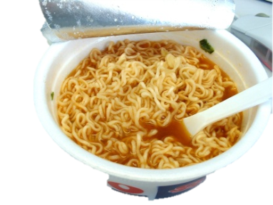
Changes in Income
The effect of changes in income on demand depends on the nature of the good in question.
A normal good: Demand increases when income increases (and vice versa).
An inferior good: Demand decreases when income increases (and vice versa).
Back to Table of contents
Notes:
Teaching Tip: Ask the students what things they currently purchase but plan to stop buying once they graduate and get a full-time job. You’re likely to get lots of examples of inferior goods.

Slide 13
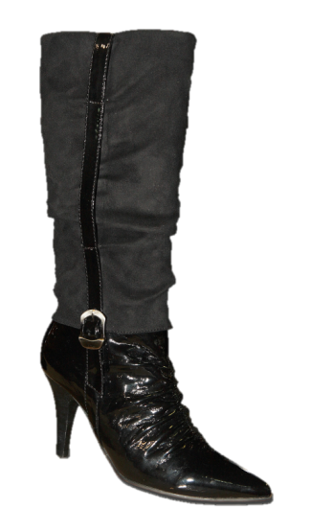
Changes in Tastes
Tastes and preferences are subjective and vary among consumers.
Seasonal changes or fads have a predictable effects on demand.
What happens to demand for boots in October?
Back to Table of contents
Notes:
Instructor Notes: There are tons of examples here, and students may need a few to get the hang of it.
The Atkins diet craze influenced the types of food people ate. Consumers switched away from carbohydrates and started eating more red meat. Of course, when Dr. Atkins died of a heart attack, dieters began to rethink their food choices and started consuming less red meat.
Advertising tries to influence tastes and preferences. Students will easily recognize this. A good exercise would be to talk about both good and bad television commercials.

Slide 14

Changes in Expectations
Timing of a purchase and expectations:
Buyers adjust current spending in anticipation of the direction of future prices in order to get the lowest price.
If prices for Xbox 360 consoles are expected to drop right before Christmas, what will happen to sales during November?
Back to Table of contents
Notes:
Instructor Notes: This one often gives students some trouble. It is important to stress that this price-demand relationship is at different points in time. Buyers will postpone purchases if they think prices will fall and will accelerate their purchases if they think prices will rise.
Many states in the United States offer sales tax holidays, during which certain goods, such as clothing, electronics, and school supplies, are exempted from state sales taxes for a brief period, typically just before school commences in the fall. Many parents time purchases for their children around these tax holidays, since the prices on things like laptops will be lower (anywhere from 4% to 7%).
Consumers tend to respond to natural disasters in the opposite direction. After a severe hurricane, for example, consumers often fear that gas prices will climb and rush to the gas stations to fill up the tanks in their cars to preempt the price increase.
From “Liquor Store Shoppers Beat Tax” by Ryan Alessi Lexington Herald Leader March 30, 2009
Ever since the Kentucky General Assembly approved a new 6% sales tax on alcohol last month, Torry Lemp had made a mental note to go on a liquor run before the levy takes effect April 1. So Lemp and his brother Terry, who was visiting from Florida, spent part of Sunday afternoon at the Beaumont Centre Liquor Barn in Lexington filling a cart with bottles of wine, vodka and tequila to save a few bucks before Wednesday.
"That's why we're here. Last time I was in here, I thought 'I have to be back here before the tax kicks in on the first,'" Torry Lemp said.
Even if Liquor Barn customers didn't know the new tax is coming when they walked into the store, it was hard to miss the dozens of fluorescent tags taped below bottles of wine, liquor and packs of beer.
Liquor Barn's "Beat the tax" tags outlined how much each bottle will cost at the register before April 1 and what it will be afterward.
One tag underneath a 1.75 liter bottle of Tanqueray Vodka noted: "Today you pay $35.29. April 1 you pay $37.40."
"That was my idea," Liquor Barn president Roger Leasor said of the tags. "And we're seeing some response from it. It's not huge but it's building."
Leasor said the Lexington area Liquor Barn stores might stay open beyond their normal 10 p.m. closing time Tuesday in case of a last-minute rush as consumers try to stock up before the tax takes effect.
Currently, liquor, wine and beer sold in Kentucky stores are taxed only on the wholesale level, so the tax is built into the price. However, bottles or drafts sold in restaurants and bars do have sales tax applied.
The legislature approved tacking on the 6% sales tax - the same level applied to products other than food and medicine - as part of a package of measures to plug an expected $456 million hole in the state budget this fiscal year, which ends June 30.
In addition to the alcohol sales tax, lawmakers raised the cigarette tax 30 cents per pack and shifted some government funds around.
Gov. Steve Beshear also is imposing 4% cuts to state agencies and 2% to universities, although the budget reductions would have been broader and deeper without the cigarette and alcohol taxes. The income from those increases will raise $52 million by July 1 and more than three times that in fiscal year 2010.
Pre-party boost expected
"I think they've got to tax something. They might as well tax booze and cigarettes," said James Mischka, who lives in Lexington on the weekends and was browsing for Seagrams vodka Sunday.
Mischka said he didn't know about the new tax until he came into Liquor Barn Sunday. But he said he didn't think it would deter him from buying alcohol.
Leasor, Liquor Barn's president, said he estimated about 30% of the stores' customers don't know that they haven't had to pay sales tax at the register on beer or liquor until the levy approved by the legislature. Now that the tax increase has generated publicity, he said, he's expecting many people with upcoming events, such as weddings or Kentucky Derby parties, to buy their booze in the next two days.
One customer at Shoppers Village Liquors near Chevy Chase spent $639 Sunday afternoon to buy five boxes of liquor, including two cases of bourbon and a case of vodka for his mother, said clerk Shelby McCuddy.
That saved him $38 he would have paid in sales tax after April 1.
"People are taking moderate advantage of it and that will build toward Tuesday," said Leasor, whose company also owns Shoppers Village. "It'll be interesting to see what happens in April. I don't know what to expect. But I don't think it will change people's habits in the long run."
Cigarette tax a bigger hit
Josh Talbert of Lexington said the tax might hurt more this summer when he and his wife throw some barbecues. The big financial hit for the Talbert household will be the cigarette tax increase, coupled with a 62-cent federal cigarette tax increase, he said. But he hoped his wife, who smoked a pack a day before becoming pregnant, will use the 92 cents per pack jump in taxes as motivation to quit.
Torry Lemp said Sunday marked his second day being cigarette-free, although he admitted to chomping on cigars to help ween [sic] him off a habit he's had for 32 of his 46 years.
That, he said, might be the best result of all the tax increases.
"I can't afford to smoke anymore," he said. "It's time to quit anyway for my health. I want to live a lot longer."
Reach Ryan Alessi at (859) 231-1303.

Slide 15
When the price of petroleum goes up,
the demand for natural gas ______,
the demand for coal ______, and
the demand for solar power ______.
(Assume these goods are all substitutes for petroleum.)
increases; increases; increases
increases; increases; decreases
decreases; decreases; increases
decreases; decreases; decreases
To Next
Active Learning
Back to Table of contents
Notes:
Correct answer is A

Slide 16
Which of the following will cause an increase in the demand for autos?
Price of car tires increases because of a Malaysian rubber shortage.
Concrete steel reinforcing rods are replaced by aluminum along the Atlantic coast to prevent rusting.
Gasoline prices drop by 50% when OPEC nations increase production.
McDonald’s increases its hamburger production in response to consumer trends.
To Next
Active Learning
Back to Table of contents
Notes:
Correct answer is C

Slide 17
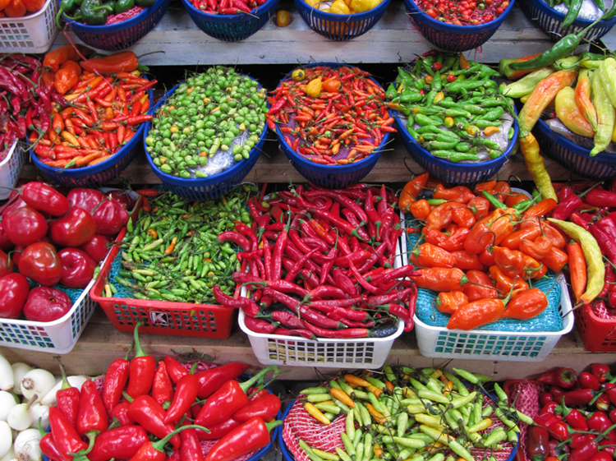
Supply
Supply represents the behavior of sellers.
A supply curve shows the quantity supplied at various prices.
The quantity supplied is the quantity that producers are willing and able to sell at a particular price.
Back to Table of contents

Slide 18
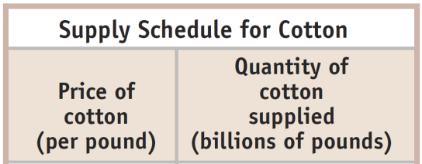
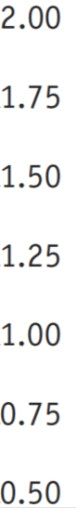
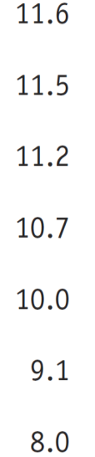
The Supply Schedule and the Supply Curve
Price of cotton
(per pound)
Supply curve, S
$2.00
1.75
As price rises, the quantity supplied rises.
1.50
1.25
1.00
0.75
0.50
0
7
9
11
13
15
17
Quantity of cotton (per pound)

Slide 19
An Increase in Supply
Price of coffee beans (per pound)
S
1
S
2
$2.00
A movement along the supply curve…
1.75
1.50
1.25
1.00
… is not the same thing as a shift of the supply curve.
0.75
0.50
0
7
9
11
13
15
17
Quantity of coffee beans (billions of pounds)

Slide 20
Shifts of the Supply Curve
An increase in supply means a rightward shift of the supply curve.
Price
S
3
S
1
S
2
Increase in supply
A decrease in supply means a leftward shift of the supply curve.
Decrease in supply
Quantity

Slide 21
Understanding Shifts of the Supply Curve
Important supply shifters include changes in:
input prices.
the prices of related goods or services.
technology.
expectations.
the number of producers.
Back to Table of contents
Notes:
Instructor Notes:

Slide 22

Changes in Input Prices
A decrease in the price of an input (all else equal) increases profits and encourages more supply (and vice versa).
What will happen to the number of new businesses if the government reduces the fees and red tape associated with new business licenses?
What happens if the fees rise?
What about TAXES?
What about SUBSIDIES?
Back to Table of contents
Notes:
It is important for students to note that producers of finished goods are demanders for inputs used to make those finished goods. It might be a good idea to pick a product that students are familiar with, say a car or a truck, and ask them what is used in its production. Students should see pretty quickly that the prices of these inputs affect the cost of producing the finished and good and ultimately the supply.

Slide 23
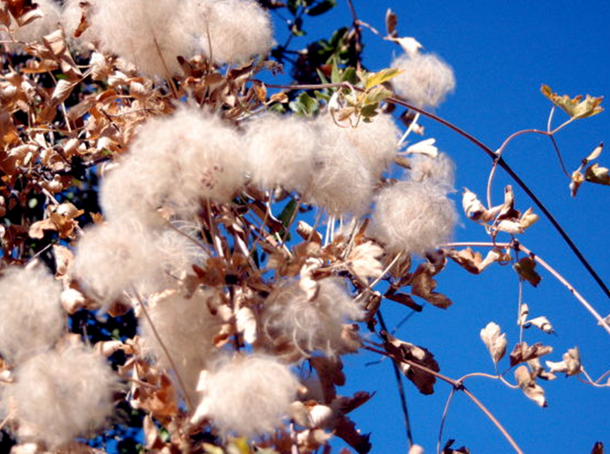
Changes in Input Prices
When the price of cotton drops, the supply of
blue jeans increases.
Back to Table of contents

Slide 24

Changes in the Price of Related Goods or Services
Inputs used in production have opportunity costs. Sellers will choose to use inputs whose profit is the highest.
There are substitutes and complements in production processes.
Complement in pork processing? Lard.
Substitute in corn production? Cotton.
Back to Table of contents
Notes:
Instructor Notes: Students will have a good bit of difficulty grasping this one. Remind them that all activities involve an opportunity cost.
From the Associated Press, August 18 2008:
“Last year, high corn prices helped fuel a switch from cotton acreage in Louisiana. This year, high soybean and rice prices “contributed to the all-time low in cotton acreage planted in the state,” said Nathan Crisp, director of Louisiana’s branch of the National Agricultural Statistics Service.”

Slide 25
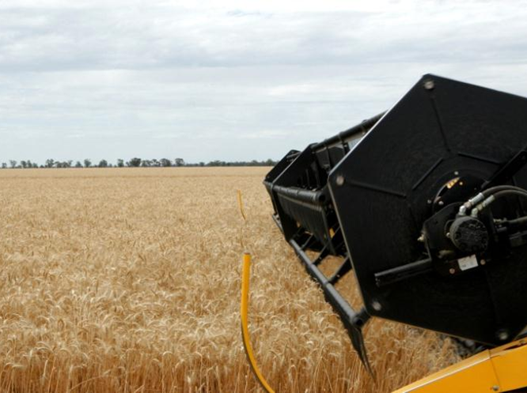
Changes in Technology
A technological innovation lowers costs and increases supply.
Back to Table of contents

Slide 26

Changes in Expectations
The expectation of a higher price for a good in the future decreases current supply of the good – if they can store the good (and vice versa).
Sellers will adjust their current offerings in anticipation of the direction of future prices in order to obtain the highest possible price.
What is the future direction of Games?
Back to Table of contents
Notes:
Instructor Notes: As on the demand side, this one often gives students some trouble (probably more so). It is important to stress that this price–supply relationship is at different points in time. Sellers will accelerate current production for sale if they think prices will fall in the future and will delay current production if they think prices will rise in the future.
From The Wall Street Journal, “We Can Lower Oil Prices Now” by Martin Feldstein, July 1, 2008:
“… Unlike perishable agricultural products, oil can be stored in the ground. So when will an owner of oil reduce production or increase inventories instead of selling his oil and converting the proceeds into investible cash? A simplified answer is that he will keep the oil in the ground if its price is expected to rise faster than the interest rate that could be earned on the money obtained from selling the oil. The actual price of oil may rise faster or slower than is expected, but the decision to sell (or hold) the oil depends on the expected price rise.”

Slide 27

Changes in Number of Producers
As producers enter and exit the market, the overall supply changes.
Entry implies more sellers in the market, increasing supply.
Exit implies fewer sellers in the market, decreasing supply.
As more firms enter the solar installation market, the number of solar installations available for sale increases.
Back to Table of contents
Notes:
Instructor Notes:

Slide 28
Finding the Equilibrium Price and Quantity
Price of cotton (per pound)
When Q_{s} = Q_{d} at a certain price, the market is in equilibrium.
That is, the amount consumers would purchase at this price is matched exactly by the amount producers wish to sell.
Supply
$2.00
1.75
1.50
1.25
Equilibrium price
E
Equilibrium
1.00
0.75
0.50
Demand
0
7
10
13
15
17
Equilibrium quantity
Quantity of cotton (billions of pounds)

Slide 29
Why Does the Market Price tends to Fall if It Is Above the Equilibrium Price?
Price of cotton (per pound)
Surplus = Qs > Qd
Supply
$2.00
Surpluses do not last long: why?
1.75
Surplus
1.50
1.25
1.00
E
0.75
0.50
Demand
0
7
8.1
10
11.2
13
15
17
Quantity demanded
Quantity of cotton (billions of pounds)
Quantity supplied

Slide 30
Why Does the Market Price Rise If It Is Below the Equilibrium Price?
Price of cotton (per pound)
Shortages: Qd > Qs
Supply
Shortages do not last: why, or what will happen?
$2.00
1.75
1.50
1.25
1.00
E
0.75
0.50
Shortage
Demand
0
7
9.1
10
11.5
13
15
17
Quantity supplied
Quantity demanded
Quantity of cotton (billions of pounds)

Slide 31
What Happens When the Demand Curve Shifts
Price of cotton
An increase in demand…
Supply
… leads to a movement along the supply curve due to a higher equilibrium price and higher equilibrium quantity.
E
2
P
2
Price rises
E
1
P
1
D
2
D
1
Q
1
Q
2
Quantity of cotton
Quantity rises

Slide 32
What Happens When the Supply Curve Shifts
Price of cotton
S
2
S
A decrease in supply…
1
E
2
P
2
Price rises
… leads to a movement along the demand curve due to a higher equilibrium price and lower equilibrium quantity.
P
1
E
1
Demand
Q
Q
Quantity of cotton
2
1
Quantity falls

Slide 33

How do you know what caused a price change? Or which curve?
Look at the outcome:
if the price and quantity move together, it was a demand change.
If they move in opposite directions, a supply change.

Slide 34
SIMULTANEOUS Shifts of Supply and Demand
(a) One possible outcome: Price rises, quantity rises.
Price of cotton
Small decrease in supply
S
2
S
1
E
Two opposing forces determining the equilibrium quantity:
2
P
2
The increase in demand dominates the decrease in supply.
E
1
P
1
D
2
D
1
Large increase in demand
Q
1
Q
2
Quantity of cotton

Slide 35
Simultaneous Shifts of Supply and Demand
(b) Another possible outcome: price rises, quantity falls
Price of cotton
Large decrease in supply
S
2
S
1
Two opposing forces determining the equilibrium quantity:
E
2
P
2
The decrease in supply dominates the increase in demand.
E
1
Small increase in demand
P
1
D
2
D
1
Q
Q
Quantity of cotton
2
1

Slide 36
Consumers in Mayville consider houses and apartments to be substitutes. There is an increase in the price of houses in Mayville at the same time three new apartment buildings open there. In the market for apartments in Mayville:
the equilibrium price will rise.
the equilibrium price will fall.
the equilibrium quantity will rise.
the equilibrium quantity will fall.
Notes:
Correct answer is C

